Slide 1
Digital Portfolio
STUDENT NAME: SAI VARSHINI K
REGISTER NO AND NMID: 2426J1558 AND asbruaz2426J1558
DEPARTMENT: BSC INFORMATION TECHNOLOGY
COLLEGE: COLLEGE/ UNIVERSITY:KPR College Of Arts Science And Reasearch/Bharathiyar University

Slide 2
PROJECT TITLE
Smart-waste-management

Slide 3


AGENDA
Problem Statement
Project Overview
End Users
Tools and Technologies
Portfolio design and Layout
Features and Functionality
Results and Screenshots
Conclusion
Github Link
3/21/2024 Annual Review

Slide 4

PROBLEM STATEMENT
Inefficient Waste Collection
Traditional methods rely on fixed schedules rather than actual bin usage. This leads to some bins overflowing and others being collected when still half-empty, causing inefficiency.
Environmental&Health Hazards
Overflowing garbage bins create unhygienic conditions, spread diseases, attract pests and stray animals, and contribute to air and land pollution in urban areas..
HighOperational Costs
Unnecessary trips to half-filled bins increase fuel consumption, manpower costs, and traffic congestion. Municipal authorities spend more while achieving less efficiency

Slide 5

PROJECT OVERVIEW
IoT-EnabledReal-TimeMonitoring
The system uses smart bins equipped with ultrasonic sensors to continuously measure the waste level. This data is transmitted to an IoT cloud platform, ensuring accurate and real-time tracking of garbage bins across different locations.
Smart Dashboard with Alerts and Route Optimization A centralized dashboard allows municipal authorities to remotely monitor all bins, receive instant alerts when a bin is nearly full, and generate optimized collection routes. This reduces unnecessary trips, fuel wastage, and manpower inefficiency.
Improved Efficiency and Sustainable Waste Management By combining IoT technology with data analytics, the system ensures timely collection of waste, cleaner public spaces, and reduced operational costs. It directly supports the vision of sustainable development and smart city initiatives.

Slide 6

WHO ARE THE END USERS?
Municipal Corporations and Local Authorities They are the primary users who can monitor waste bins across the city, receive alerts, and plan optimized garbage collection routes, reducing time and costs.
Residential Societies, Apartments, and Institutions Housing complexes, schools, colleges, and offices can use the system to maintain cleaner surroundings and manage waste more efficiently on their premises.
Smart City Developers and Government Agencies For large-scale urban projects, this system plays a crucial role in promoting sustainability, reducing pollution, and ensuring hygienic public spaces as part of smart city initiatives.

Slide 7
TOOLS AND TECHNIQUES
Programming Language:
HTML, CSS, JavaScript
Database Management System (DBMS):
Firebase / MySQL (optional – only if storing form data or user inputs)
Version Control:
Git, GitHub
Development Environment:
VS Code (Visual Studio Code)
Deployment Platform:
GitHub Pages / Netlify / Vercel

Slide 8
POTFOLIO DESIGN AND LAYOUT
Clean and User-Friendly Interface The portfolio/dashboard is designed with a simple and intuitive layout that allows users to easily monitor bin levels. Graphs, charts, and color indicators (green, yellow, red) help in quickly identifying the status of waste bins.
Organized and Structured Presentation The design includes separate sections for real-time monitoring, alerts, route planning, and data analytics. Each section is neatly arranged to avoid clutter and make the information easy to understand at a glance.
Responsive and Scalable Layout The system is designed to work across multiple platforms including desktops, tablets, and mobile devices. The layout is
flexible and can be scaled to monitor a few bins for small communities or thousands of bins for smart city projects.
8

Slide 9
FEATURES AND FUNCTIONALITY
Real-Time Waste Level Monitoring Each smart bin is equipped with sensors that continuously measure the waste level and send data to the IoT cloud. This feature ensures that authorities always have up-to-date information on the status of every bin.
Alerts and Optimized Route Planning The system automatically generates alerts when a bin is nearly full. At the same time, it provides optimized collection routes for garbage trucks, saving fuel, manpower, and time by avoiding unnecessary trips to half-empty bins.
Data Analytics and Reporting The dashboard not only shows real-time data but also provides insights through analytics and reports. These reports help authorities track waste generation patterns, forecast future needs, and make better decisions for sustainable waste management.

Slide 10
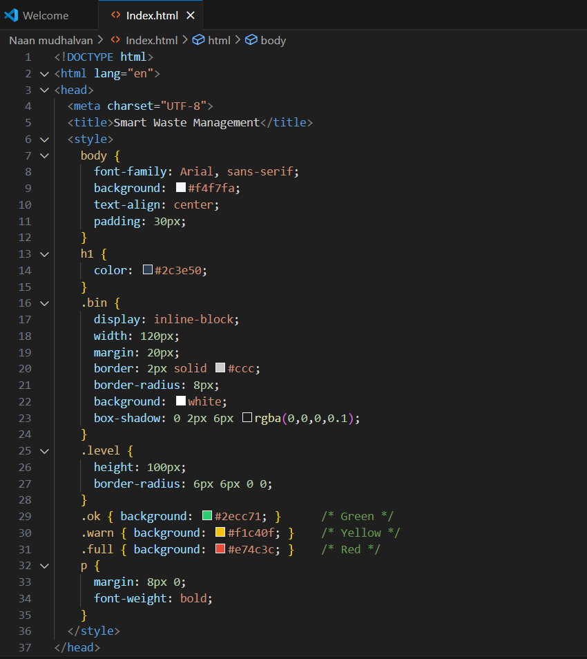
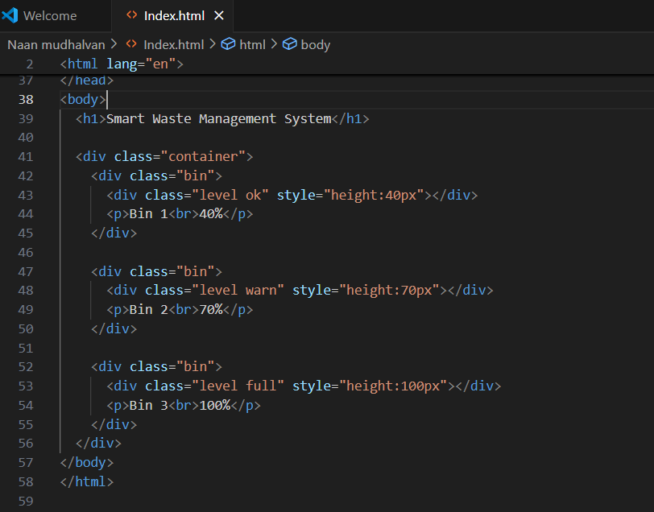
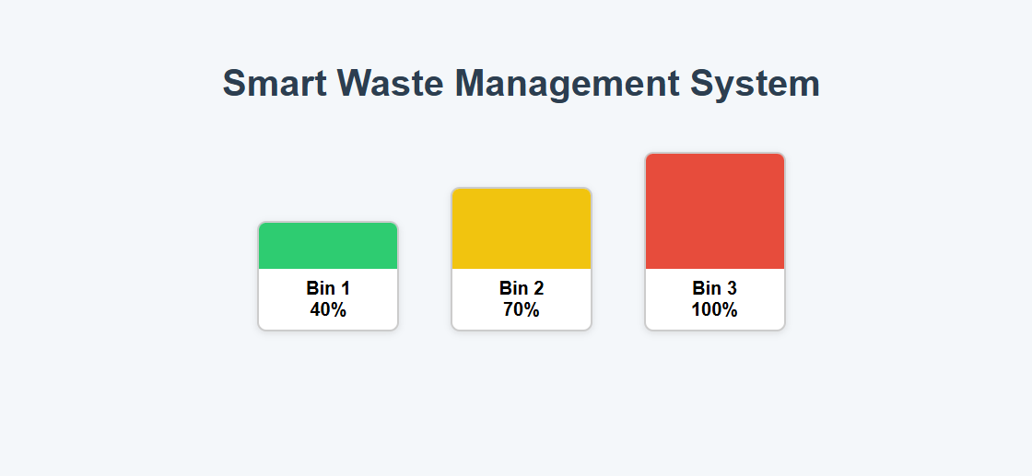
RESULTS AND SCREENSHOTS
3/21/2024 Annual Review
10

Slide 11
CONCLUSION
Efficient Waste Collection The system ensures timely garbage collection through real-time monitoring, which reduces overflowing bins and keeps public spaces clean.
Cost and Resource Savings By providing optimized routes and avoiding unnecessary trips, it saves fuel, time, and manpower, making waste collection more efficient and economical.
Support for Smart Cities The project promotes sustainability and hygiene while aligning with the vision of smart cities, improving both environmental and social well-being.
Git-Hub Link:
11

